Slide 1
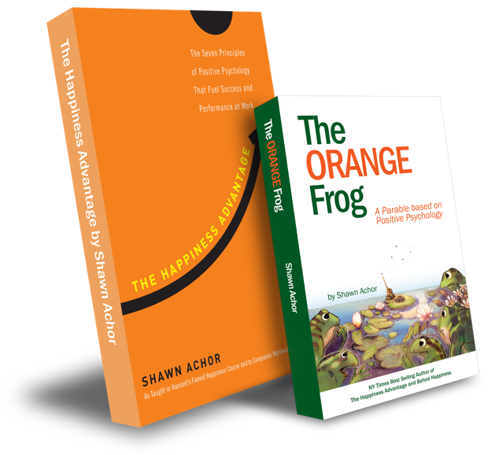
The Happiness Advantage
and
The Orange Frog
By Shawn Achor

Slide 2
Elementary Week Two

Slide 3
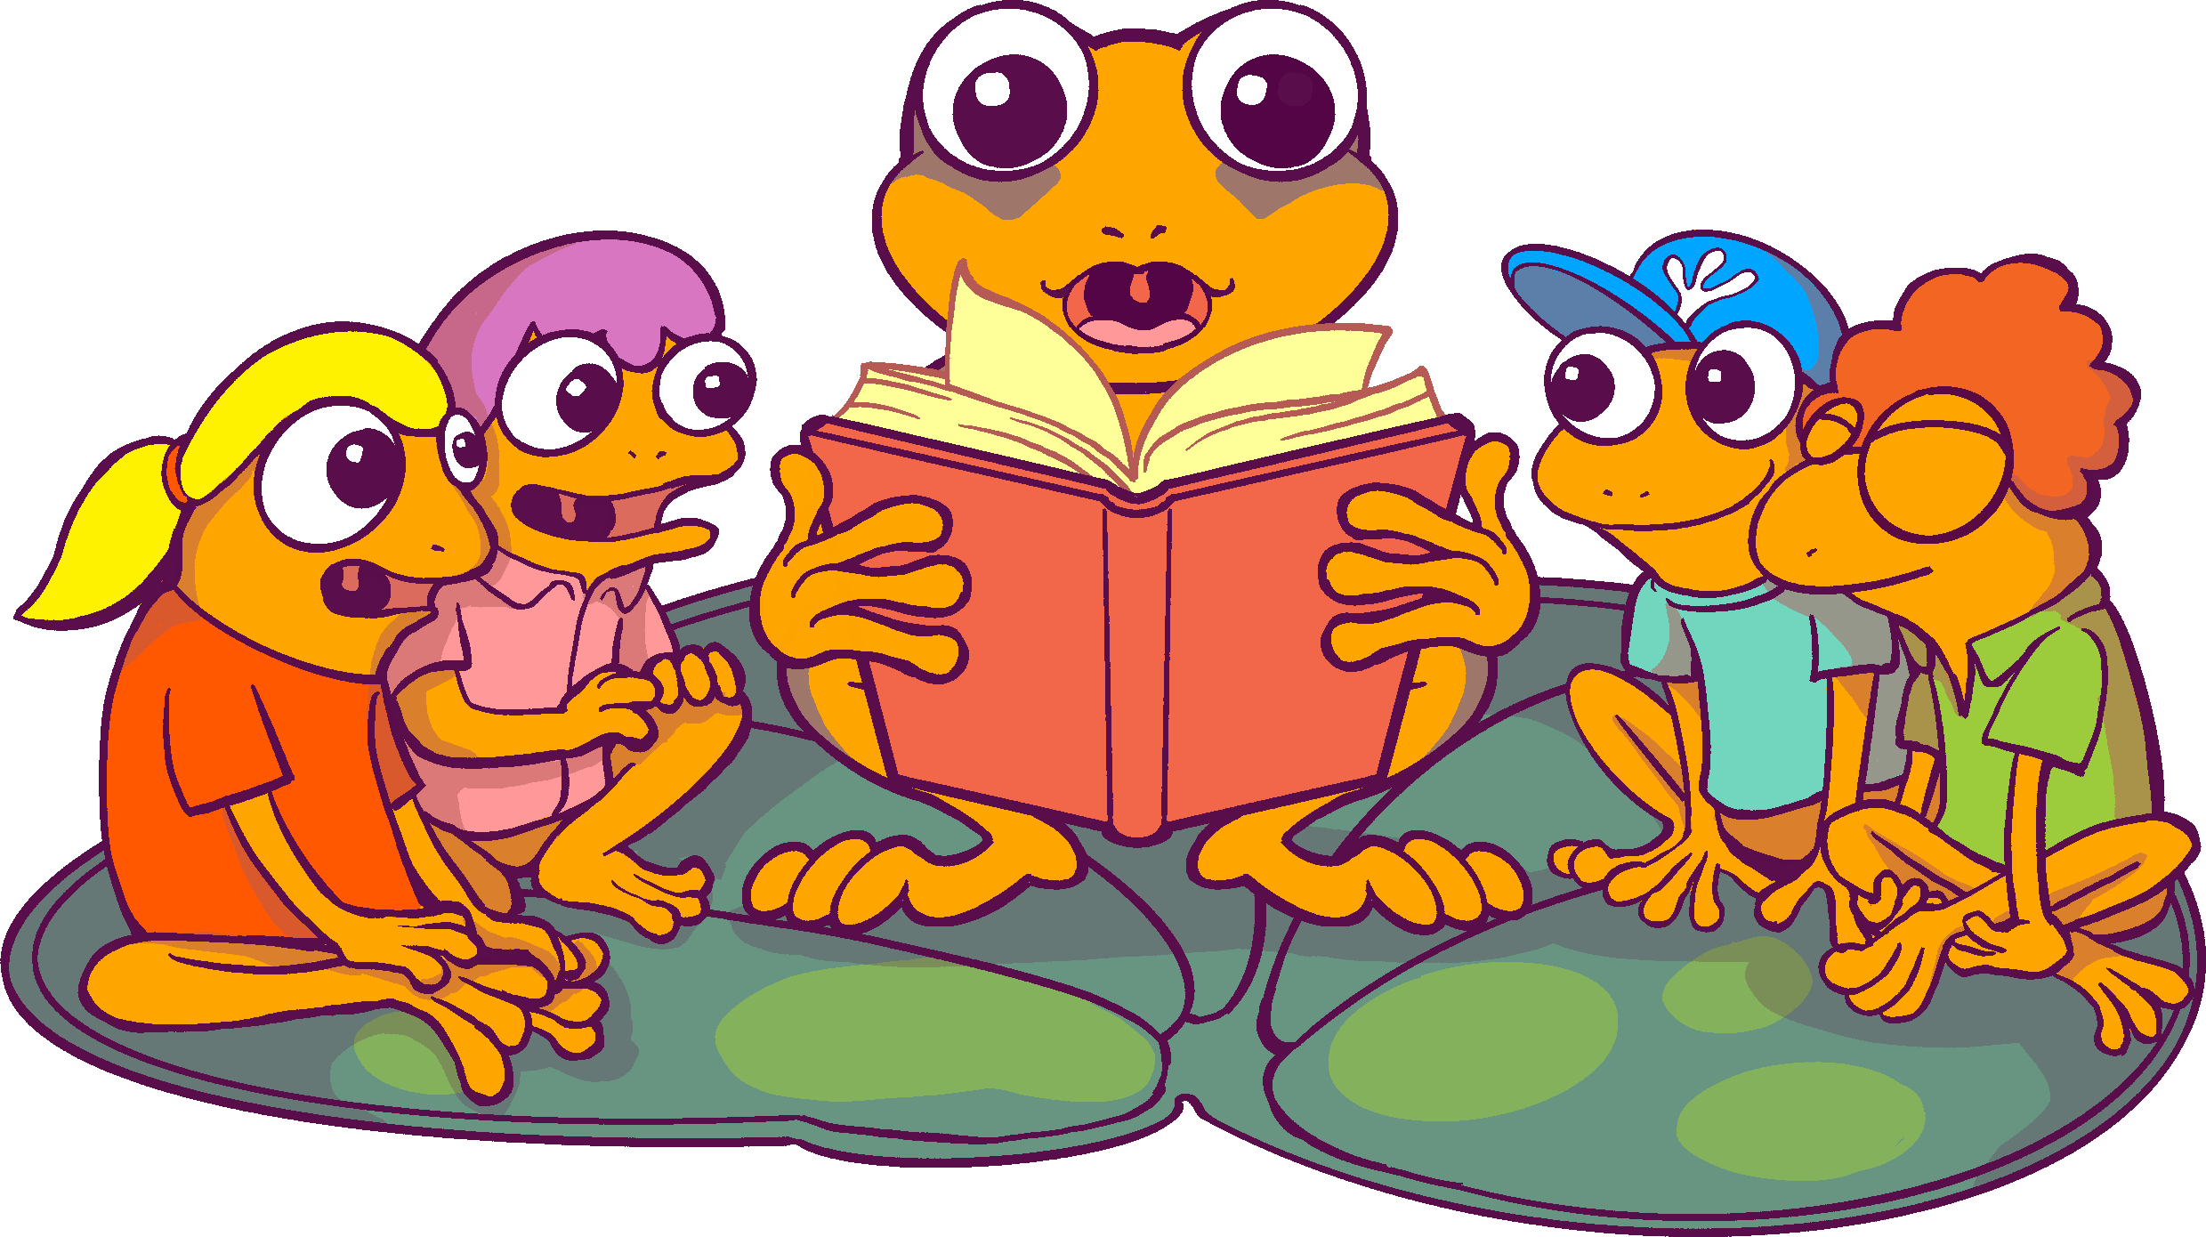
The Orange Frog
Learning Objective:
I can listen to the Orange Frog story
I will discuss the central theme of The Orange Frog and will discover connections for my everyday life.
Notes:
Standard:
Essential Concept and/or Skill: Communicate and work productively with others emphasizing collaboration and cultural awareness to produce quality work.
Interact positively as a team member.
Cooperate with others in a group setting.
Generate ideas with group members.
Are active listeners.
Read and understand information in a variety of forms.
Express ideas.
Skill:
Active listening, express ideas

Slide 4
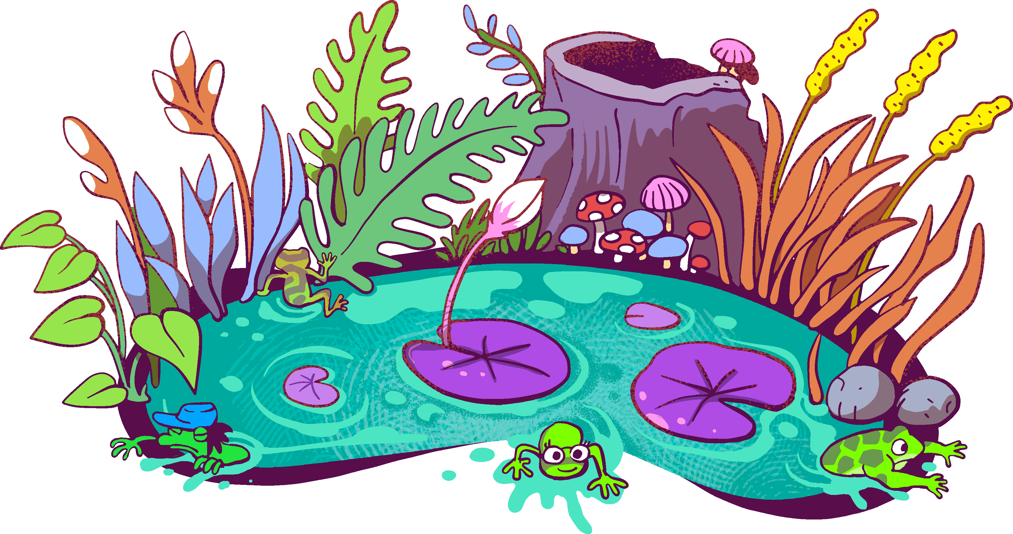
Skills
Interact positively as a team member.
Cooperate with others in a group setting.
Generate ideas with group members.
Are active listeners.
Read and understand information in a variety of forms.
Express ideas.

Slide 5
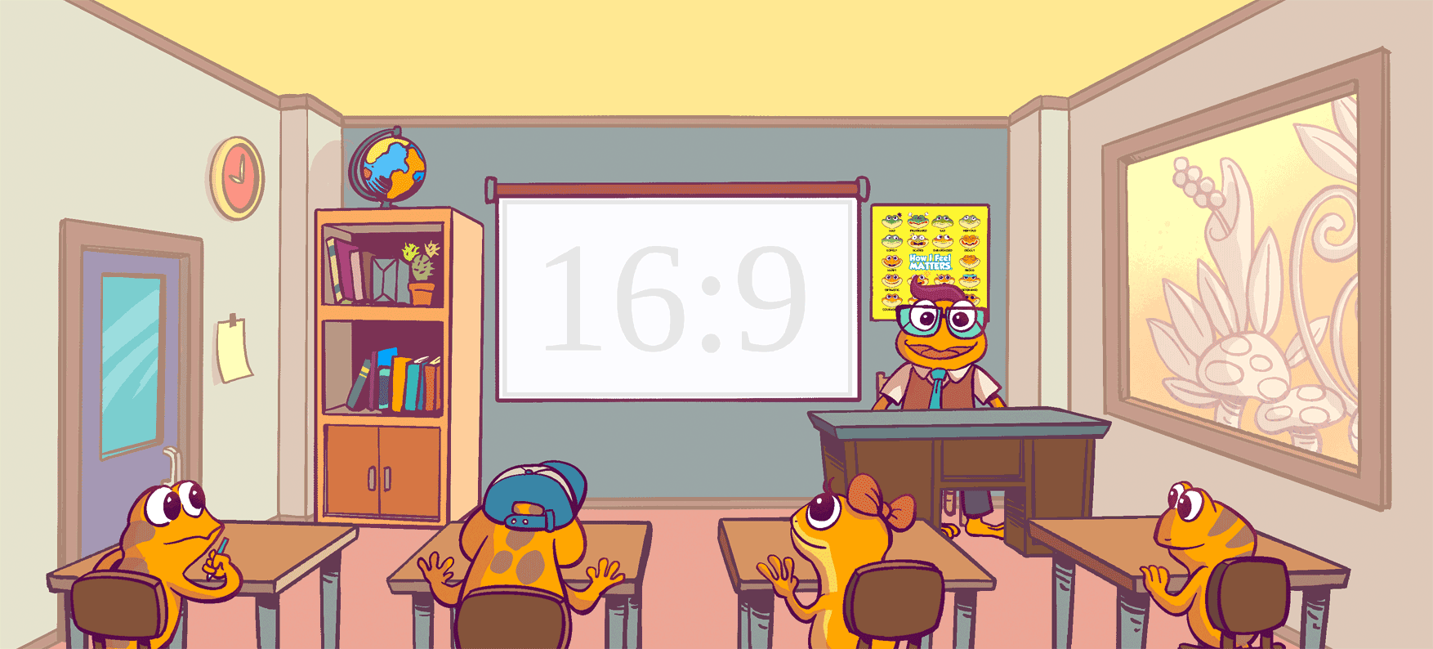
Being Orange – Feeling Different – Five Tactics (p. 7-12)
Notes:
Presenter Notes: Click forward to automatically play The Orange Frog Kid’s book. Click forward once more to view the video in full screen.

Slide 6
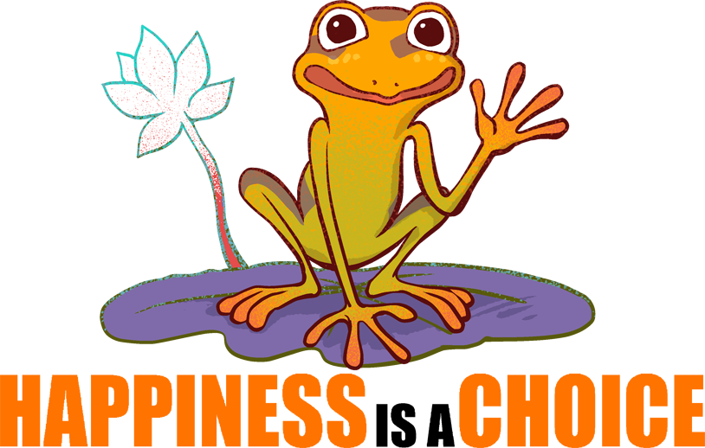
Thoughts
It’s hard to be different. At first, Misty tries to talk to Spark about what he can do to be like everyone else. It didn’t take long for Spark to realize that being Green didn’t feel nearly as good as being Orange.
Being Orange is a choice.

Slide 7
Action
Spark knew that when he was green, he didn’t feel as good as being Orange.
What types of things can we do to become more Orange?
We are going to look at the images and discuss which picture best fits with the action. These actions are known to help others become happier and healthier.”

Slide 8
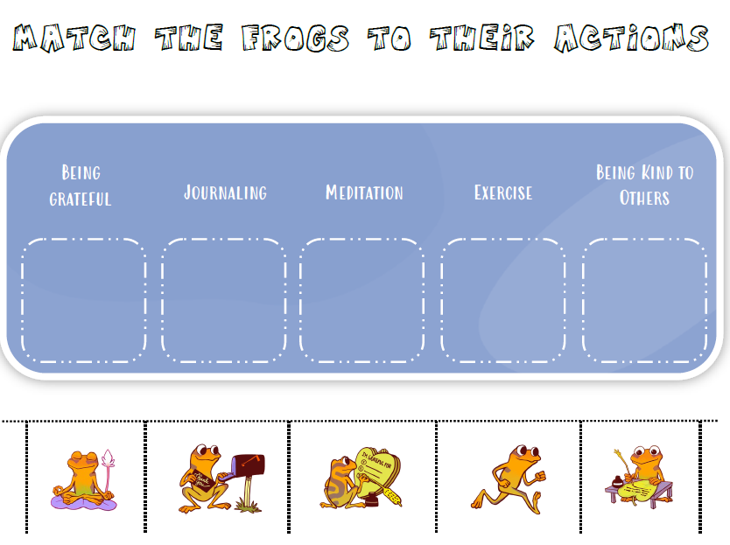
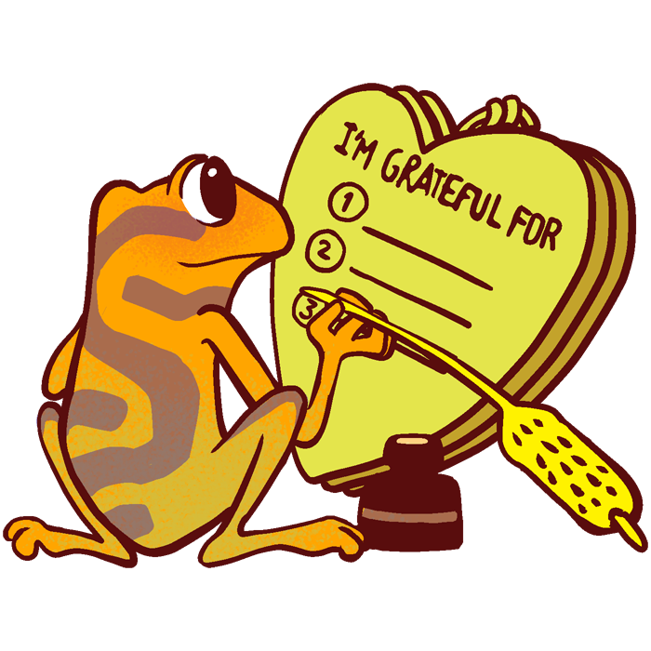
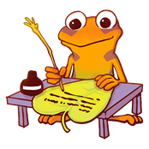
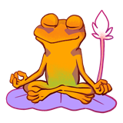
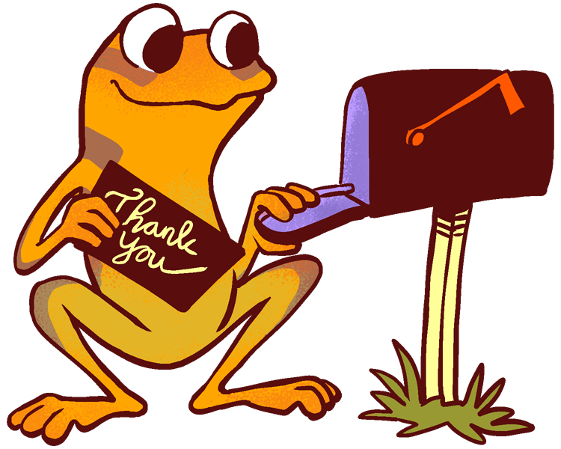
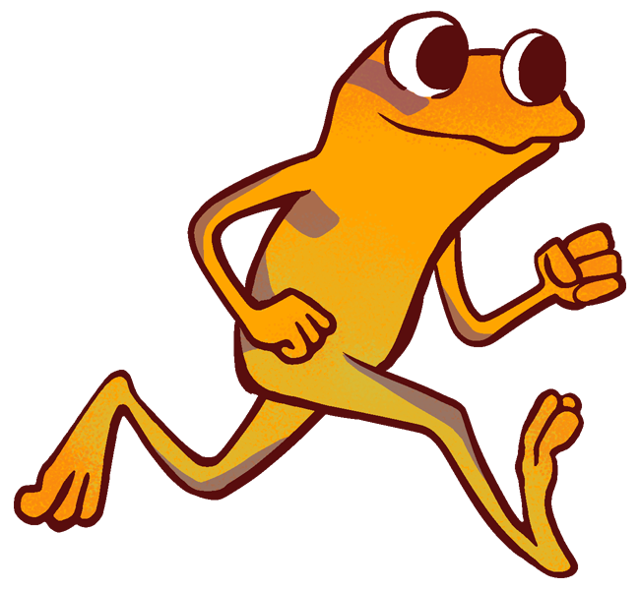
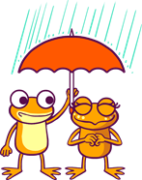
ACTIVITY
Notes:
You can either use this as a group activity and share on a projector or print out copies provided on the website for students to cut and paste the pictures on their own.

Slide 9
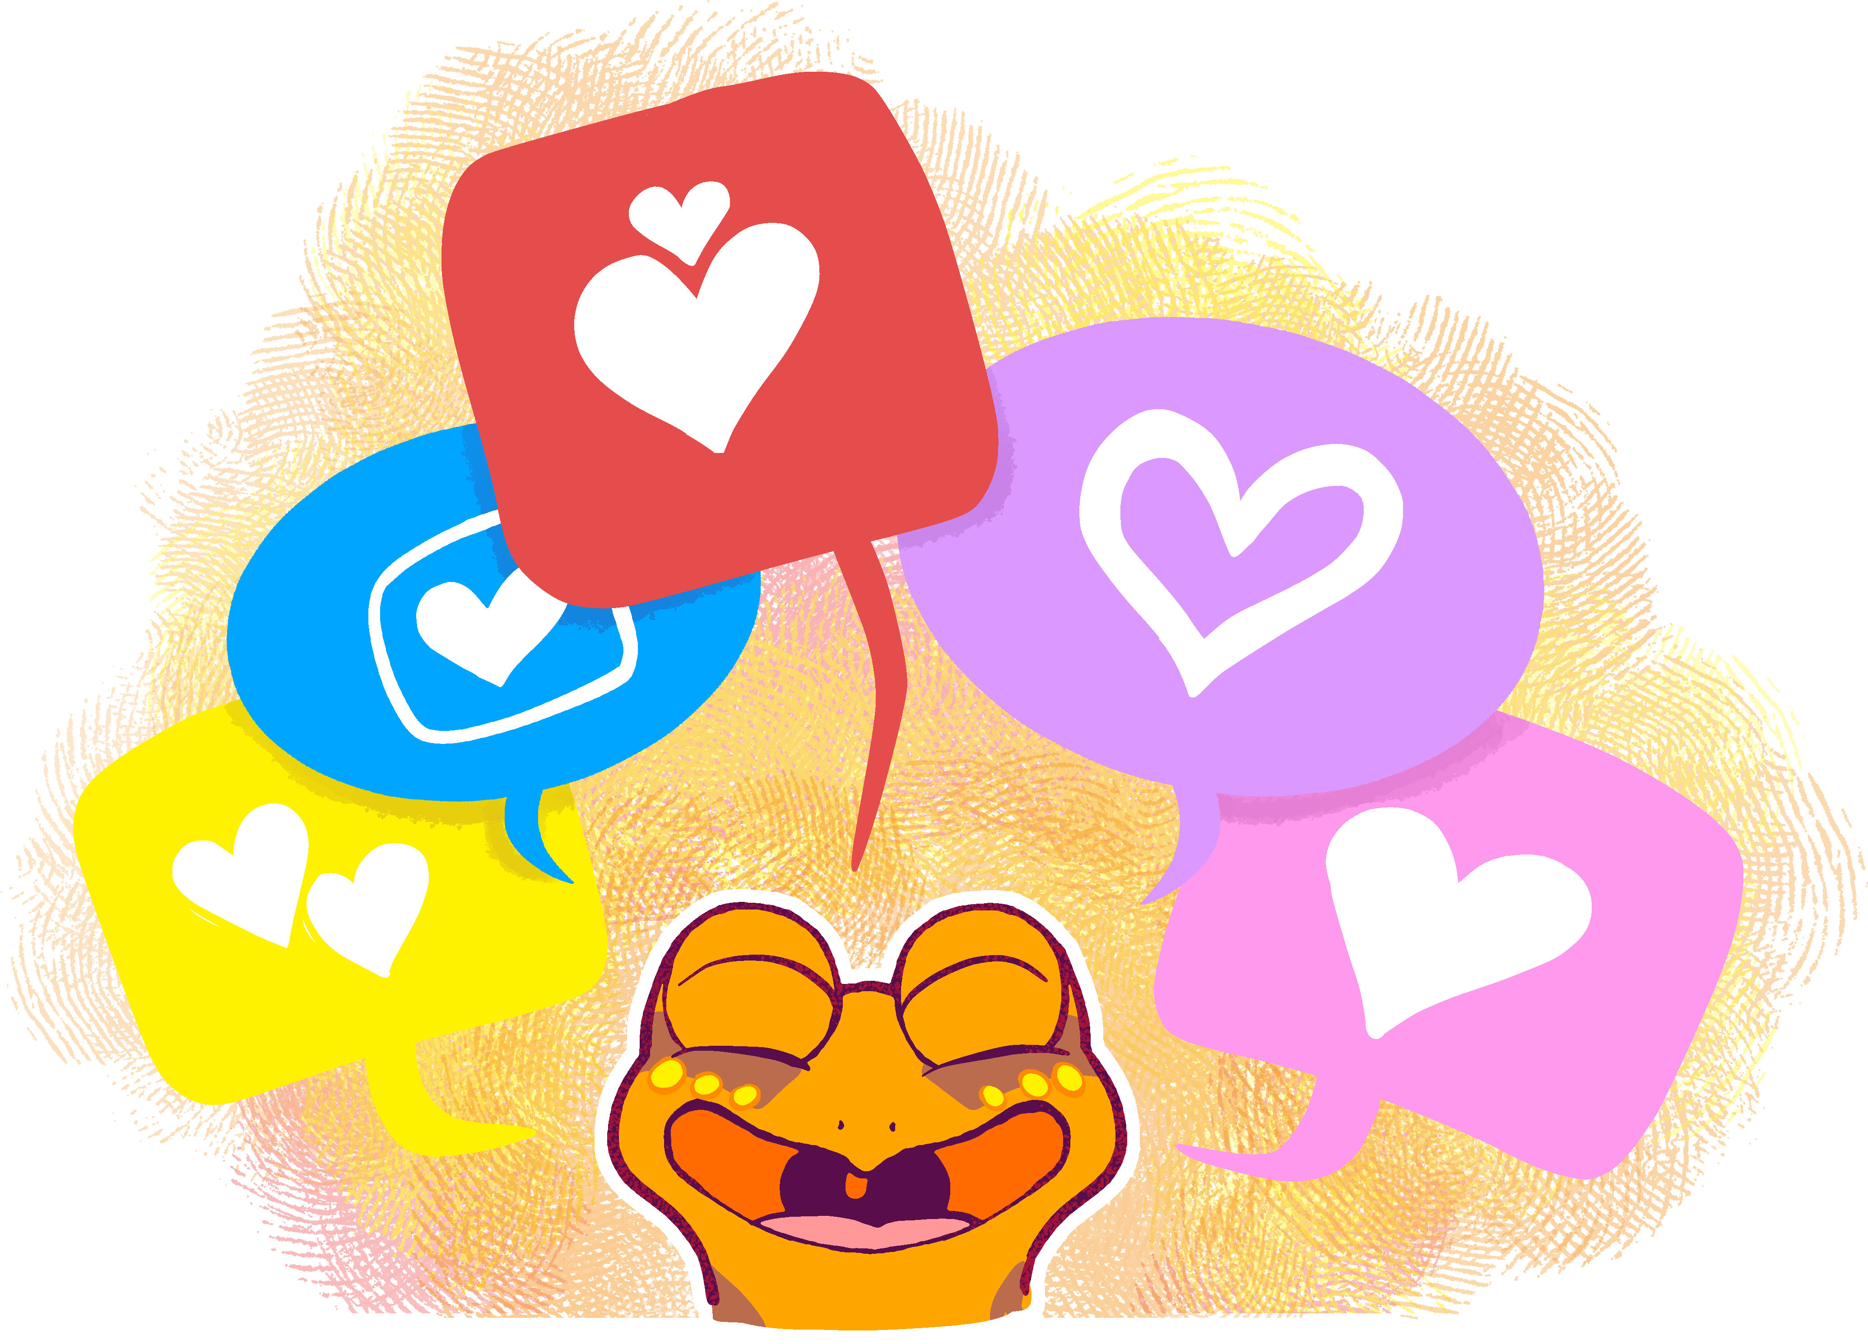
BONUS
Can others tell when you’re being kind like Spark?
Have you ever thought you wanted to be like everybody else?
What kind of activities do you like to do?
Make a prediction. What do you think would happen to Spark if he stopped doing the things he loves? Why?
Notes:
Spark would turn green, as the thrall is highly contagious. Positivity and negativity are both contagious!

